Slide 1
Modeling
What is Scientific Modeling?
Notes:
Materials: L0 HO and EP
L0 learning goals:
Students develop a definition of models and create a class list of model criteria:
Epistemic learning goals (ELG):
As a community we have criteria that we can use to develop, evaluate, and revise models. These are shared norms we all agree to and follow.

Slide 2
STOP & THINK!
Grab a packet and put your name and information on the top of the first page.
Complete the STOP & THINK! question on the first page.
What is a scientific model? Explain and give an example of a scientific model.
Notes:
Use this “Stop & Think” as a do now. Tell students they will be thinking about what is a scientific model and what makes for a good scientific model in this next activity.
Do not hold a class discussion at this point. Just let them do the STOP & THINK, maybe solicit one or two answers and move on. Keep this very brief.

Slide 3

Scientific Reasons
Scientists provide a lot of reasons for their explanations and how they figured them out in order to convince others.
We need to give good reasons when we explain, too!
I think almost all rocks sink. I know this because I did an experiment with 50 different types of rocks and they all sank.
Notes:
Scientific Reasons: tell the students that before we discuss scientific models, we first need to discuss the importance of giving reasons in science. Emphasize to students that scientists and non-scientists, like lawyers and accountants, give reasons for their suggestions. The goal is for students to develop a habit of articulating reasons, asking others for reasons and generating productive disagreement. Even when they agree, students should still make sure they agree for the same reasons. When we discuss what is a scientific model they will have to back their ideas with reasons!
[The content is somewhat secondary at this point because they don’t have a lot of evidence to support their arguments.]

Slide 4
Giving Reasons
From now on, whenever you discuss in groups or as a whole class make sure to:
Ask for reasons.
Give reasons.
Try to agree about two things:
Your answer to problems or questions
Your reasons for your answers.
Why do you think so?
How do you know?
I know because…
Notes:
Remind students of the goal for today’s discourse in class. Remind students that It’s OK if they end up disagreeing, but they should discuss things thoroughly to see if they can come to an agreement.
As they work later in the activity, walk around and make sure they are in fact using the stems, giving and asking for reasons . Give them positive feedback when they do, and push them to use the stems if they are not. Reasons are really critical piece of science, the more you emphasize them the better the students will be at articulating their ideas in speech and writing.

Slide 5
Evaluating Models
What makes a good scientific model?
Individually, look at a pair of models and decide which is better.
Then, compare your choices to your partner’s choices and decide which you both think is better.
Write down why you think one model is better.
Do this for all the model pairs.
Read the instructions on the top carefully; the question at the top of the page changes.
Remember to give and ask for reasons!
Notes:
Evaluating models (20-25 min) Tell students that in the next activity they will continue giving reasons when thinking about and evaluating models. This time the focus is on what makes for a good model. Explain the task, as described in the slide, to the students. They need to move back and forth from individual work to pair work.
DO NOT MOVE TO THE NEXT SLIDE UNTIL STUDENTS COMPLETE THE MODEL EVALUATION.
There are 5 pairs of models and then one single model (frog). Each pair of models differs in one important aspect (which we discuss in the slides with the models- slide 8 and up). Read the notes for those slides for tips on what to push for when asking for model criteria.

Slide 6
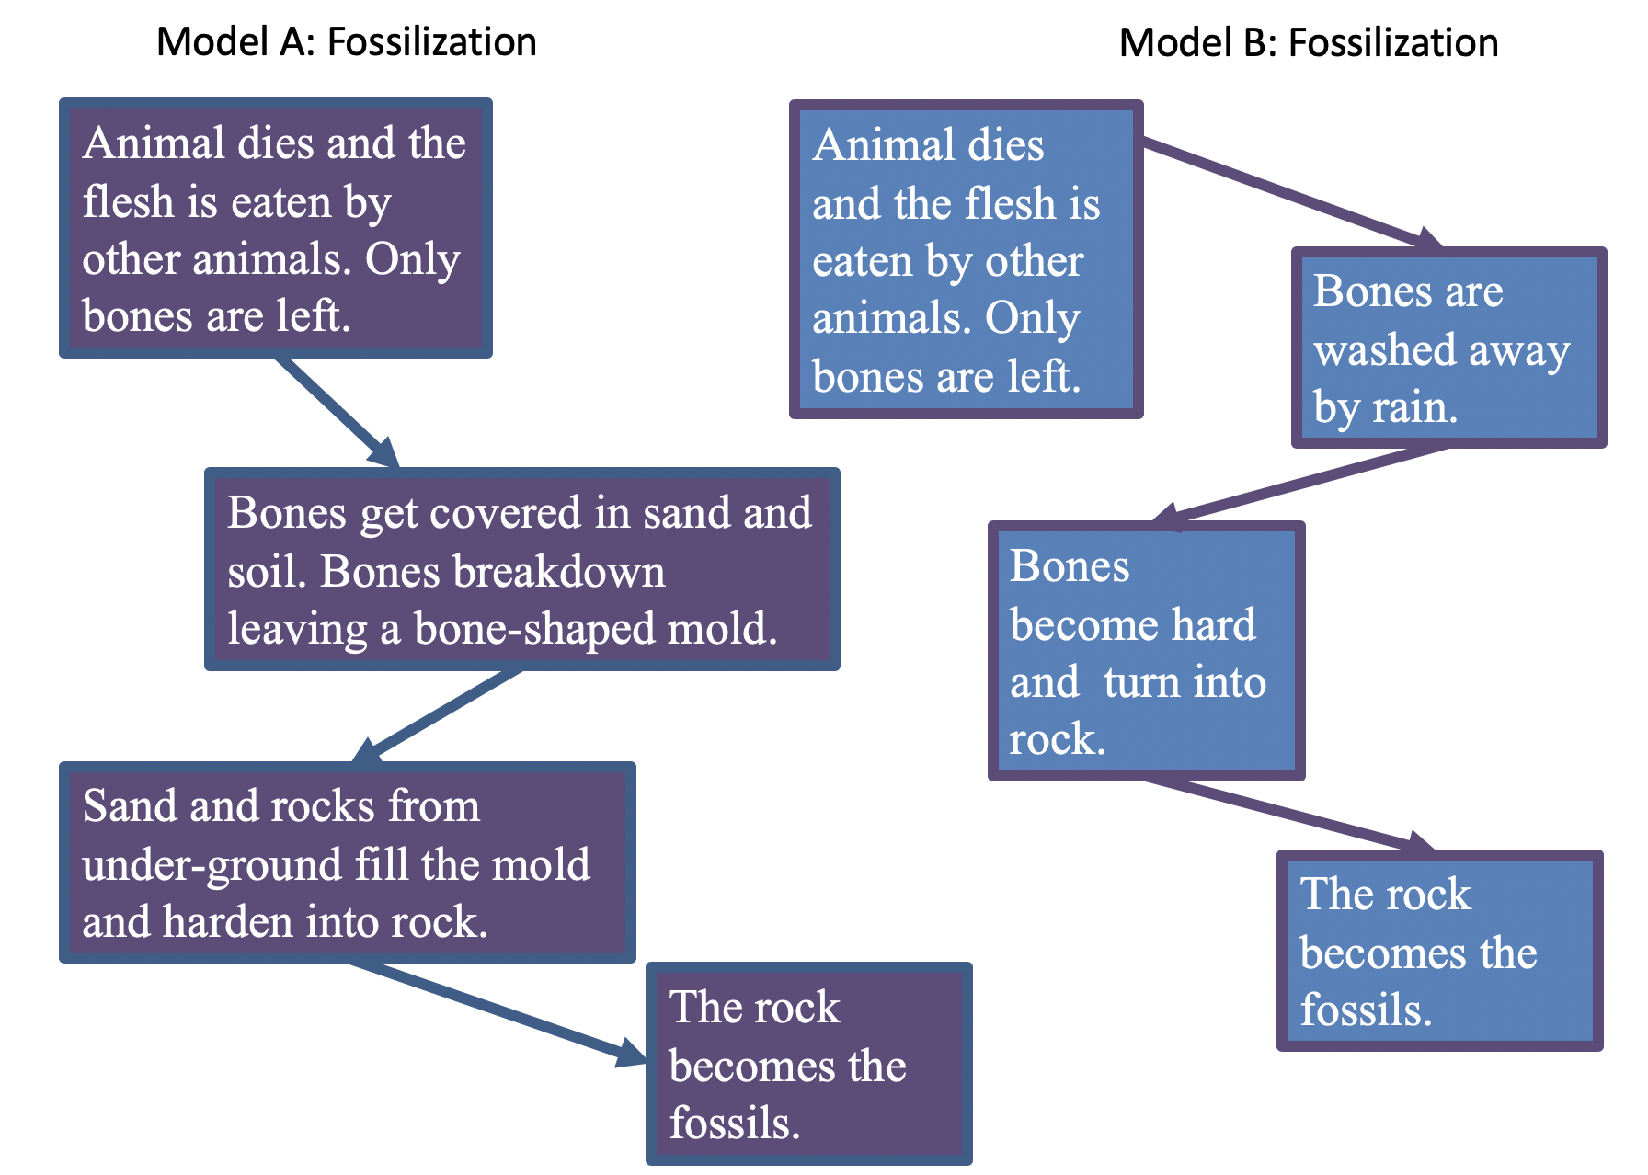
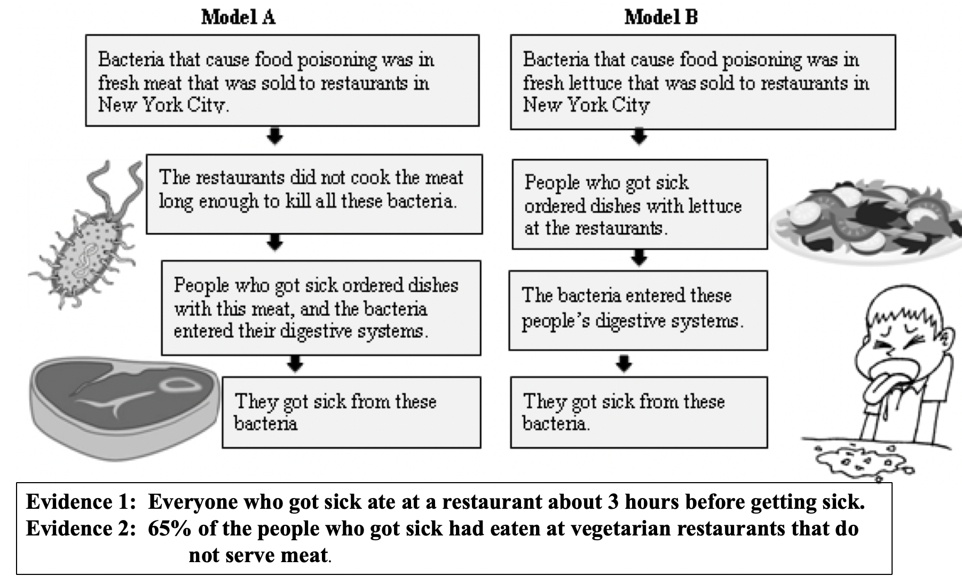
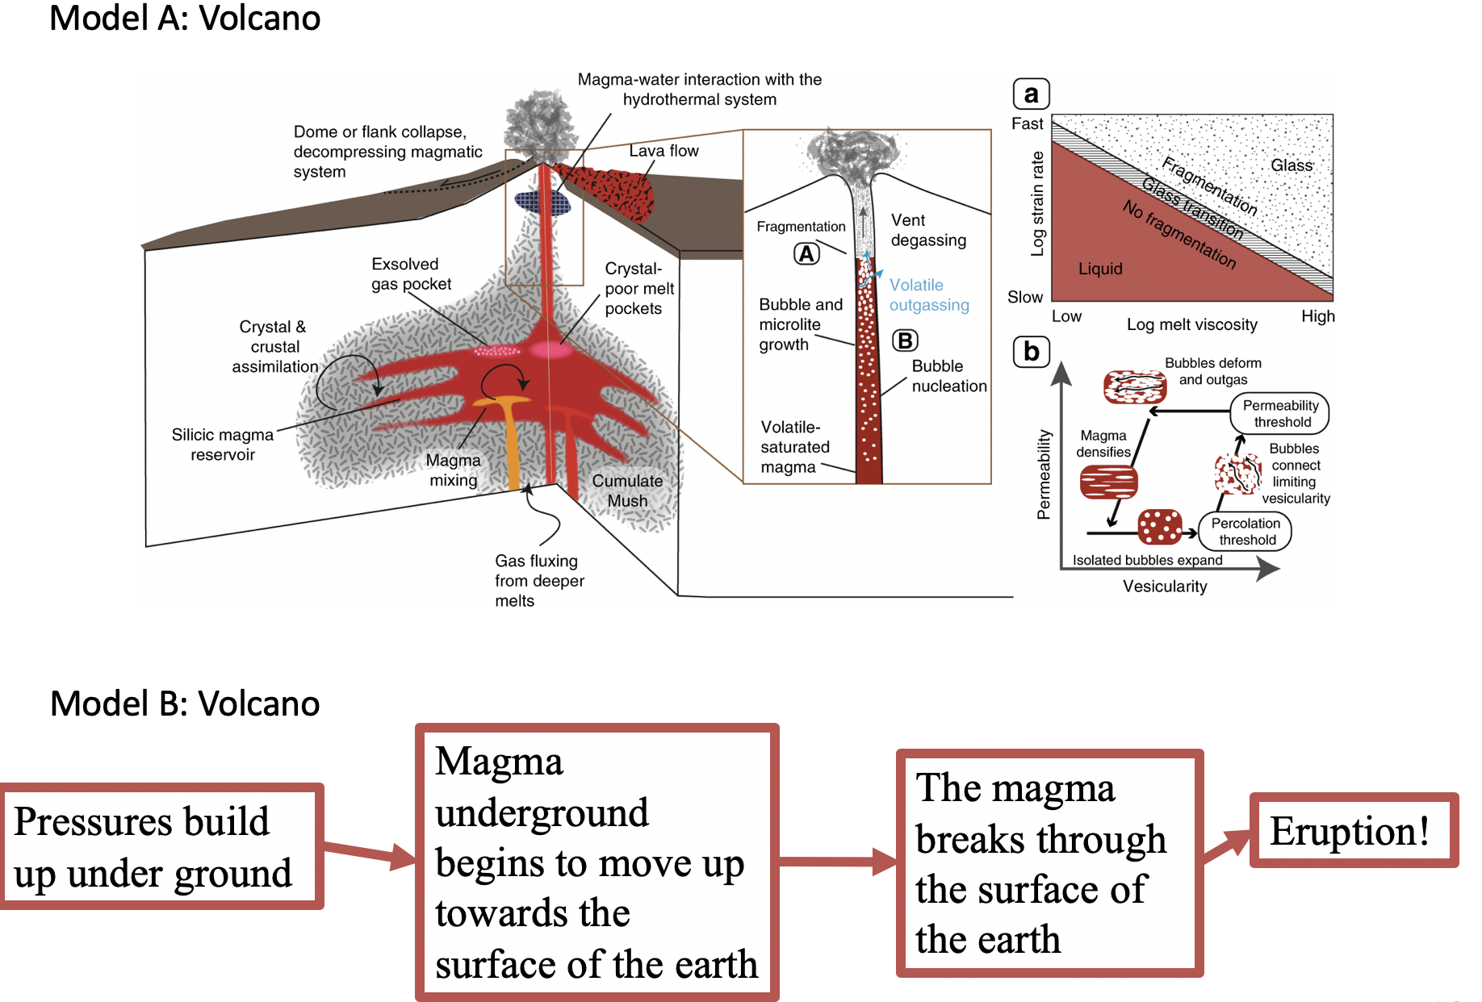
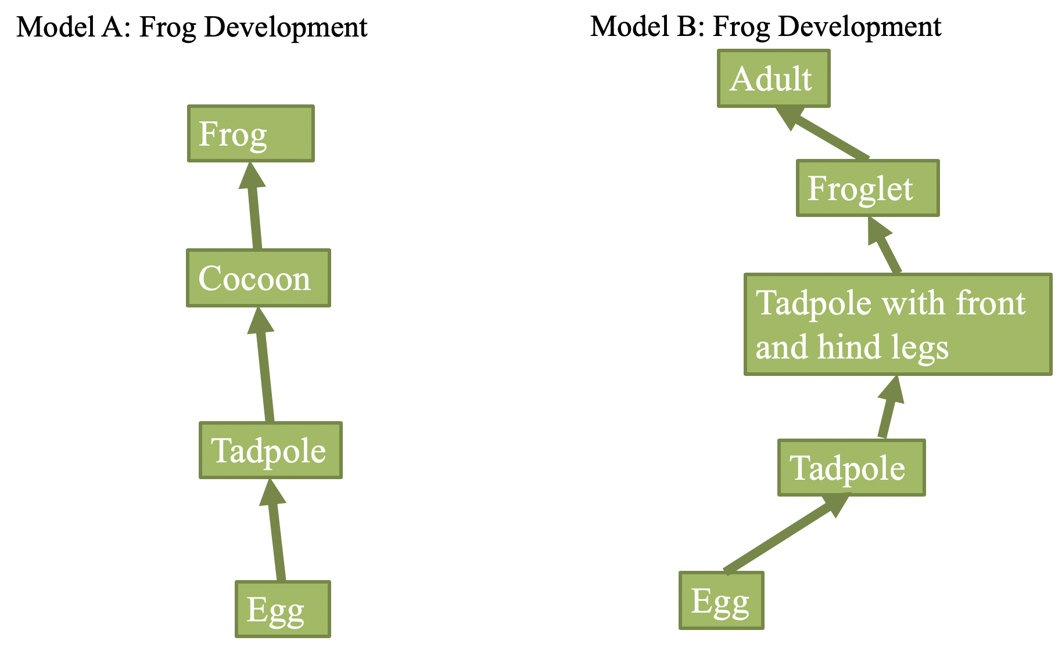
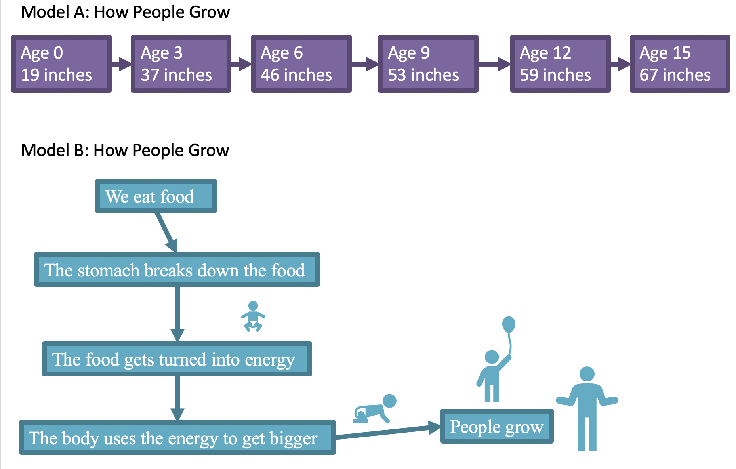
Evaluating Models
Notes:
END OF DAY 1
Evaluating models (20-25 min) Tell students that in the next activity they will continue giving reasons when thinking about and evaluating models. This time the focus is on what makes for a good model. Explain the task, as described in the slide, to the students. They need to move back and forth from individual work to pair work.
DO NOT MOVE TO THE NEXT SLIDE UNTIL STUDENTS COMPLETE THE MODEL EVALUATION.
There are 5 pairs of models and then one single model (frog). Each pair of models differs in one important aspect (which we discuss in the slides with the models- slide 8 and up). Read the notes for those slides for tips on what to push for when asking for model criteria.

Slide 7
Model Comparison Pairs
Notes:
There are 5 pairs, try to have students do as many as they can, and at LEAST the first 3. Don’t discuss each pair, let them work through all the pairs, and make sure they are on task. This should not take forever about 20-25 min for 5 pairs and the frog model.

Slide 8
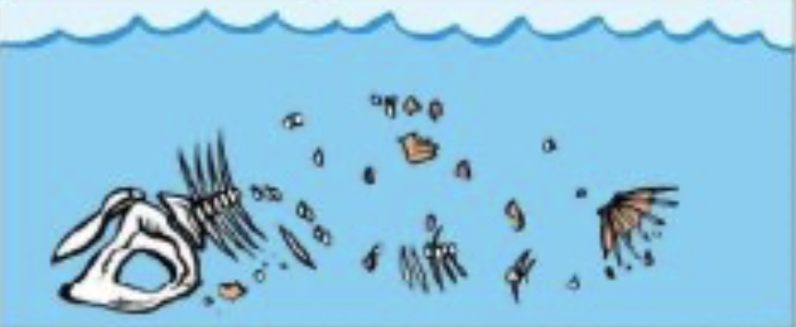
1. Which of these two models is better if you want to explain how fossils form?
Model A: Fossilization
Model B: Fossilization
Animal dies and the flesh is eaten by other animals. Only bones are left.
Animal dies and the flesh is eaten by other animals. Only bones are left.
Bones dissolve in the rain and completely disappear.
Bones get covered in sand and soil. Bones break down leaving a bone-shaped mold.
Bones become hard and turn into rock.
Sand and rocks from underground fill the mold and harden into rock.
The rock becomes the fossils.
The rock becomes the fossils.
Notes:
Differences between models:
Model B has a contradiction – it’s not possible that the bones both dissolved and washed away AND became hard and turned into rock.
Model B is inaccurate, its WRONG – bones do not turn into rock

Slide 9
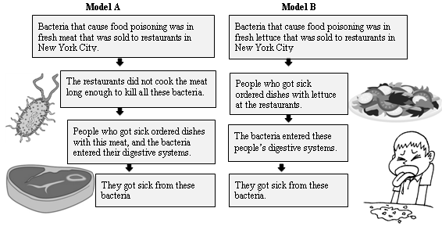
2. There was a huge outbreak of food poisoning in New York City. Health scientists developed two models of why the food poisoning occurred.
Evidence 1: Everyone who got sick ate at a restaurant about 3 hours before getting sick.
Evidence 2: 65% of the people who got sick had eaten at vegetarian restaurants that do not serve meat.
Evidence 3: All of the people who got sick had eaten lettuce.
Notes:
Differences between models:
Model A does NOT fit the evidence- it postulates meat as the cause but 65% of the people who got sick did not eat meat, and all the people who got sick had eaten lettuce.
Both models fit the first evidence, but only model B can explain the second evidence. The second evidence contradicts model A

Slide 10
3. Which of these three models is a better explanation of the development of a frog?
Model A:
Frog Development
Model B:
Frog Development
Model C: Frog Development
Adult
Frog
Adult
Sometimes there are flies
Froglet
Froglet
Tadpole
Tadpole with front and hind legs
Tadpole with front and hind legs
Egg
Sometimes it rains
Tadpole
Tadpole
Egg
Egg
Notes:
Model A is just wrong – moths/butterflies go through the cocoon transformation, frogs don’t!
Model B has more steps, and therefore explains more.

Slide 11
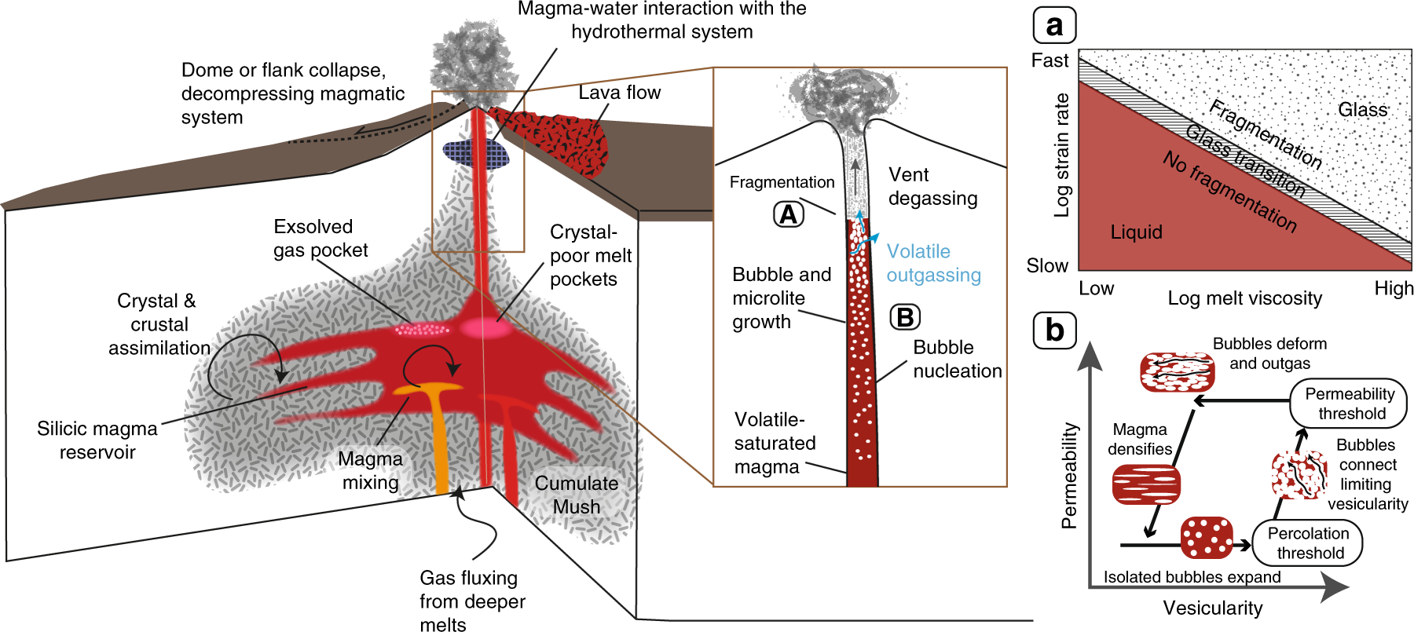
4. Which of these two models is better if you want to explain why volcanoes erupt?
Model A: Volcano
Model B: Volcano
Pressure pushes underground magma up towards the surface of the earth
The magma breaks through the surface of the earth
Pressures build up under ground
Eruption!
Notes:
Differences between models (this should help students understand the usefulness of box-and-arrow models):
Model A is prettier
Model A is very complicated, with too many details: you can’t see what’s going on
does model A not include mechanisms?
Model B isn’t as pretty
Model B is clearer: you can see the steps and understand how volcanoes form

Slide 12



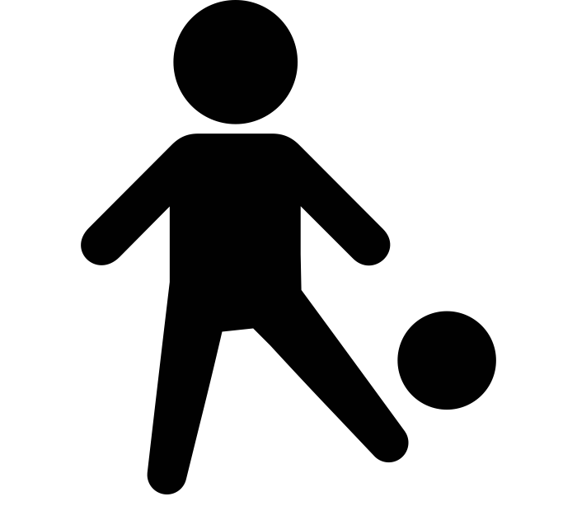


5. Which of these two models is better if you want to explain how people grow?
Model A: How People Grow
Age 0
19 inches
Age 3
37 inches
Age 6
46 inches
Age 9
53 inches
Age 12
59 inches
Age 15
67 inches
Model B: How People Grow
We eat food
The stomach breaks down the food
The food gets turned into energy
The body uses the energy to get bigger
People grow
Notes:
Differences between models:
Model A does not explain, it just shows the phenomenon without explaining WHY it happens 🡪 this doesn’t answer the question
Model B explains it a bit better (answers the question). It’s not clear that the pictures add anything here… could do without them (again, we’re trying to move kids away from wanting pictures.

